Slide 1
The Conversational Intelligence Challenge 2
Solution of “Lost in Conversation” team
Sergey Golovanov Neuromation sergey_xg@mail.ru
Alexander Tselousov Independent contributor aleksander.tselousov@yandex.ru
Speaker: Rauf Kurbanov
Neuromation JetBrains Research
kurbanov.re@gmail.com
NeurIPS 2018 Competition Track

Slide 2
Challenge
Goal:
A non-goal-oriented dialog system with a persistent persona
Problems:
Lack of a consistent personality
Lack of an explicit long-term memory
Tendency to produce non-specific answers like “I don’t know’’
Ideal solution:
Simulate a normal conversation
Learn about the interests of opponent
Discuss own interests and find common ground

Slide 3
Datasets
PersonaChat (original + revised):
Zhang S. et al. Personalizing Dialogue Agents: I have a dog, do you have pets too?
DailyDialog:
Li Y. et al. DailyDialog: A Manually Labelled Multi-turn Dialogue Dataset
Reddit comments dataset:
files.pushshift.io/reddit/comments

Slide 4
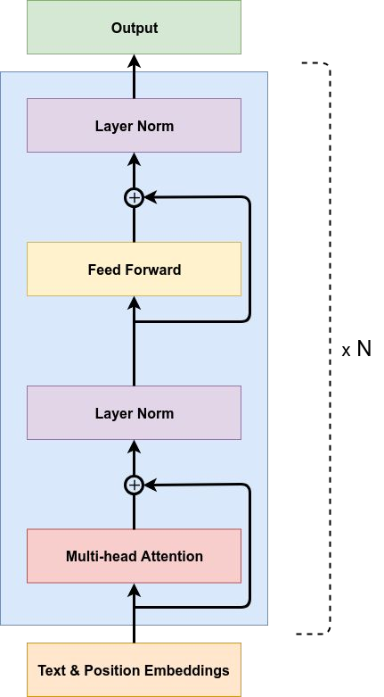
Base architecture
1
OpenAI GPT :
BPE vocabulary with 40000 tokens
Learned position embeddings with 512 positions
12 transformer layers
Multi-head attention with 768 dimensional states and 12 attention heads
Position-wise feed-forward networks with 3072 dimensional inner states
1. Radford, A., Narasimhan, K., Salimans, T., Sutskever, I. (2018). Improving language understanding by generative pre-training.
4

Slide 5
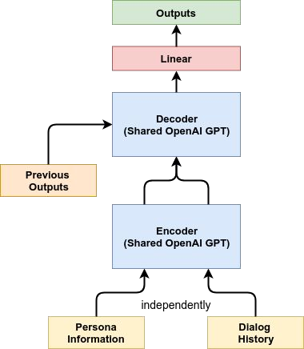
Our architecture
Shared encoder
and decoder - pretrained
OpenAI GPT¹
Shared pre-softmax linear layer and
token embeddings ²
Beam-search with length penalty
3
and
annealing for improving answer diversity
Reduction of persona information and dialog history − first and last 512 tokens respectively
Xia Y. et al. Model-level dual learning
Press O., Wolf L. Using the output embedding to improve language models
Wu Y. et al. Google's neural machine translation system: Bridging the gap between human and machine translation
5

Slide 6
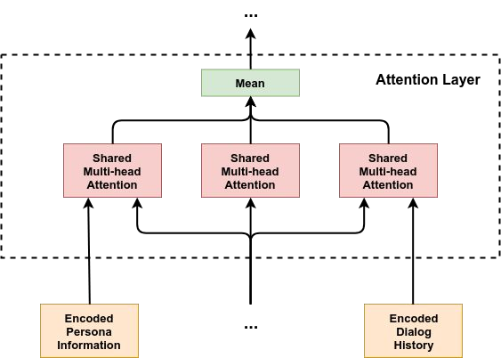
Our architecture: pretrained model
Attention layer modifications:
Shared multi-head attention layers
Parallel computation of attention for inputs
Merge of attentions - mean
6

Slide 7
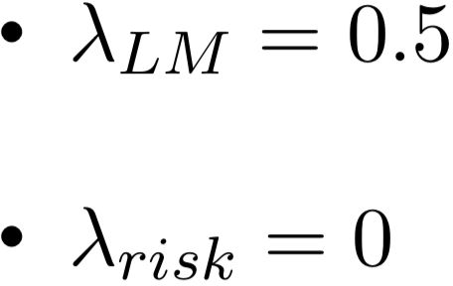
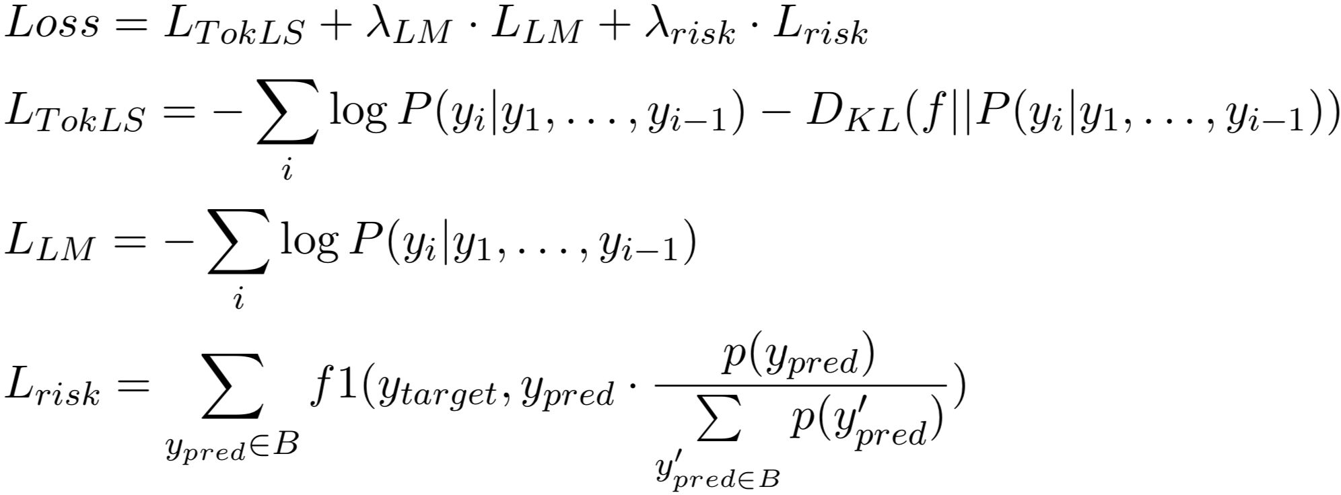
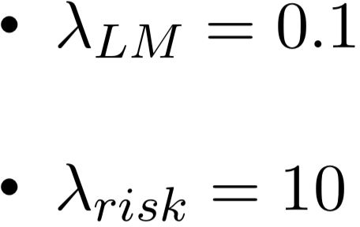
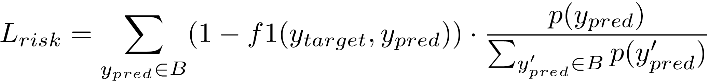
Learning procedure: loss functions
To train model we used weighted combination of losses ¹ :
First stage:
Second stage
:
Second stage
Beam-search samples
for risk minimization
1. Edunov S. et al. Classical Structured Prediction Losses for Sequence to Sequence Learning
7

Slide 8
Learning procedure: settings
Settings:
batch size: 256
learning rate: 6.25e-5
warmup: 16000
label smoothing: 0.1
dropout: 0.1
Training time:
First stage: ~ week on Nvidia GTX 1080TI
Second stage: ~ two days on Nvidia GTX 1080TI

Slide 9

Heuristics
Human behavior simulation:
Sentiment analysis of human replies and adding emoji
Mistake correction (spell, cycle conversation, ...)
Questions from retrieval model to find out additional information about an interest
Turned off: decrease automated evaluation metrics

Slide 10
Results: score
 | PPL | Hits@1 | F1
Public set | - | 0.173 | 0.179
Private set | - | 0.171 | 0.177

Slide 11
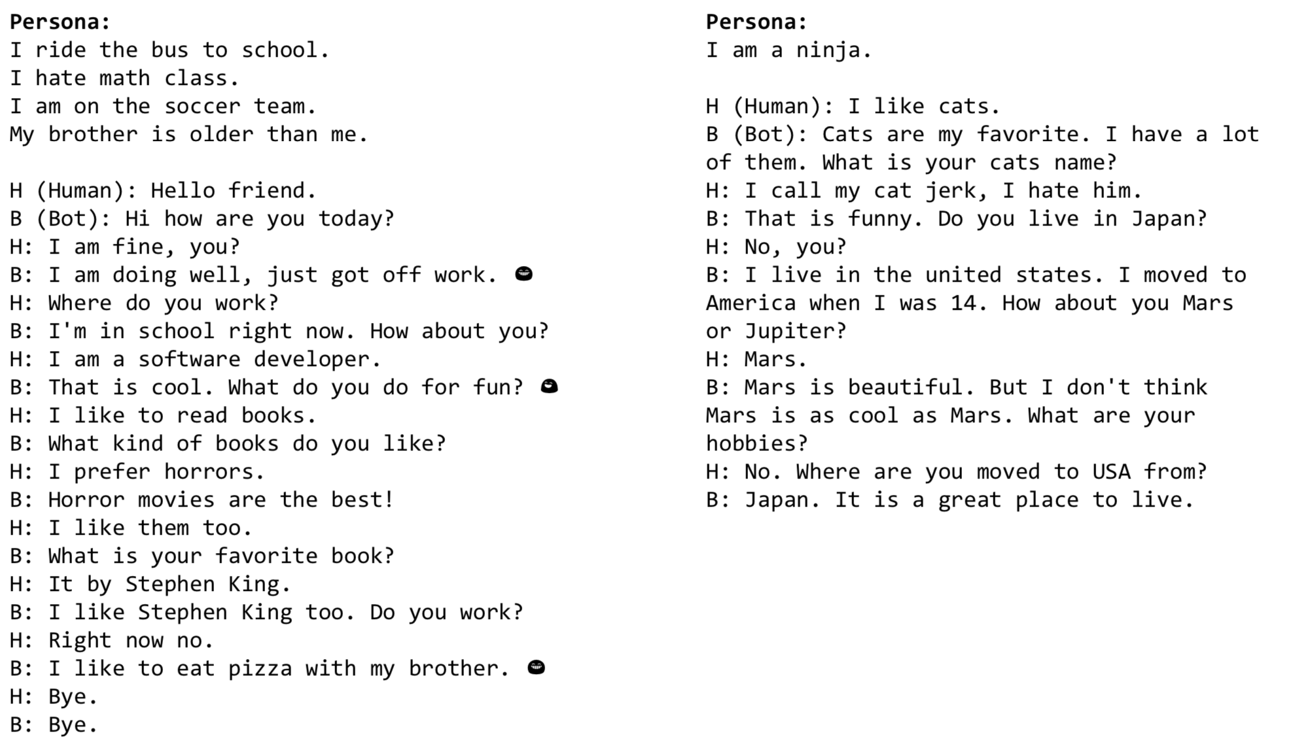
Results: dialog examples
Persona:
I ride the bus to school. I hate math class.
I am on the soccer team.
My brother is older than me.
Persona:
I am a ninja.
H (Human): I like cats.
B (Bot): Cats are my favorite. I have a lot of them. What is your cats name?
H: I call my cat jerk, I hate him.
B: That is funny. Do you live in Japan? H: No, you?
B: I live in the united states. I moved to America when I was 14. How about you Mars or Jupiter?
H: Mars.
B: Mars is beautiful. But I don't think Mars is as cool as Mars. What are your hobbies?
H: No. Where are you moved to USA from? B: Japan. It is a great place to live.
H (Human): Hello friend.
B (Bot): Hi how are you today? H: I am fine, you?
B: I am doing well, just got off work. 😁
H: Where do you work?
B: I'm in school right now. How about you? H: I am a software developer.
B: That is cool. What do you do for fun? 😄
H: I like to read books.
B: What kind of books do you like? H: I prefer horrors.
B: Horror movies are the best! H: I like them too.
B: What is your favorite book? H: It by Stephen King.
B: I like Stephen King too. Do you work? H: Right now no.
B: I like to eat pizza with my brother. 😁
H: Bye.
B: Bye.

Slide 12
Future improvements
What we wanted to do but did not have time and resources for:
Hybrid of generative and retrieval systems
Sentence compression
Attention on sentences
Dataset augmentation (translate to another language and back)
Memory and speed optimization
Critic to evaluate dialog accordance with persona
…

Slide 13



Transfer-Transfo: A Transfer Learning Approach for Neural Network Conversational Agents
The Conversational Intelligence Challenge 2 (ConvAI2)
thomas@huggingface.co
Notes:
Hello everyone,
Today, I will describe the participation of HuggingFace to the conversational intelligence challenge 2 also called ConvAI2.
HuggingFace is a New-York City based startup which is developing a conversational agent that is neither a goal-oriented agent nor a chitchat bot but which is designed to be a long term and fun companion for humans, a bit like a dog or a cat… that would talk.

Slide 14
The Conversational Intelligence Challenge 2
(NeurIPS 2018 competition)
Chit-Chatting with a coherent personality
Open domain dialog
Short conversation: <10 turns
Small talk: shallow topics, quick switches
Notes:
So the focus of Convai2 was on chitchat which has some specifies.
It’s about open-domain dialog in a setting of short conversations (less than 10 turns) and more generally small talk which means shallow topics and frequent switches in topics.

Slide 15
A Generative Transformer Model for Chit-Chat 🤖
Input and outputs: Fixed-length sequences of tokens (« words », in our case BPE)
Each output is a probability distribution for the next token in the sequence over the vocabulary of tokens.
Inside:
Self-attention layers: compute Key-Value-Query for each element of the sequence
Decoder Transformer: Causal masking in the attention heads to only attend to the past.
is
very
happy
.
Transformer Model
Bob
is
very
happy
Notes:
The model we used in the competition is a generative neural network.
More specifically a Transformer model which takes as inputs a fixed-length sequence of tokens that can be words but in our case were Byte-Pair-Encoded tokens.
The Transformer generates as outputs, for each input token, a probability distribution over the vocabulary for the next token.
Inside the Transformer, as you all probably know, there is a stack of self-attention layers separated by feed-forward and regularization layers.
Our transformer is also called a decoder transformer which means that it is constrained to have causal-attention heads by masking, for each token the subsequent tokens in the sequence.

Slide 16
Training a Neural Network Model for Chit-Chat
PERSONA-CHAT is one of the biggest multi-turn dialog dataset :
164,356 utterances and about 1-2M words
Average number of turns: 14
But it is still small for training a deep learning model:
1B words in the Billion Words dataset
~1M sentences in CoNLL 2012 (used for training co-reference systems)
And generating an engaging open-domain dialogue requires:
topic-coherence,
dialogue-flow,
common-sense,
short term memory,
co-reference resolution,
sentimental analysis,
textual entailment…
Notes:
READ THE SLIDE
So PERSONA-CHAT is still a small dataset and generating open-domain dialogue requires to model many things like:
LIST
So what can we do to learn these elements?

Slide 17
What can we do? 👻Transfer Learning 🦄
Notes:
Our solution was to use transfer learning

Slide 18
Step 1: Pre-training – Learn Natural Language Generation 🦄
Pre-train the model with a language modeling objective on a large dataset of contiguous span of texts.
This 1st stage of training learns the initial parameters of the neural network model.
The combination of the language modeling objective and un-shuffled dataset was shown to provide the model with some kind of world knowledge and an ability to process long-range dependencies.
More recently these kind of pre-trained Transformer models have been shown to improve the state of the art on many downstream NLP tasks and in particular in commonsense-knowledge tasks.
In our experiments, we started from the model of Radford et al. pre-trained on the Toronto Book dataset with ~7k books.
A Simple Method for Commonsense Reasoning by Trinh & Le (2018), Improving, Language Understanding by Generative Pre-Training by Radford et al. (2018), Universal Language Model Fine-tuning for Text Classification by Howard and Ruder (2018), BERT: Pre-training of Deep Bidirectional Transformers for Language Understanding by Jacob Devlin et al (2018)
Notes:
Transfer Learning consists of a two steps process in which the first step is unsupervised (or self-supervised) pre-training on a large corpus of data followed by a fine-tuning step.
In our case, the model is pre-trained with a LM objective on the Toronto Book Corpus.
The hope is that this pre-training will provide the model with some kind of world knowledge as well as a good ability to process long-range dependencies and generate long-range coherent sequences.
We started from the pre-trained model open-sourced by OpenAI in April which was the only large scale model of this kind as the time of the competition.

Slide 19
Step 2: Fine-tuning – Learn How to Hold a Conversation 👩‍🏫
Notes:
Now that the model has learned to capture some aspects of language, we need to teach it about dialog.

Slide 20
Encoding a Dialog and a Persona
Now that our model is provided with basic common-sense and some capabilities to generate coherent long-range linguistic structures, we need to teach it the specificities of dialog:
Alternating utterances
Dialog flow (« speech/dialog acts »)
Conditioning on a personality
How to build a sequential inputs for our model from a conditioned dialog?
Unlike RNN/LSTM, Transformers don’t possess an inherent notion of sequentiality and position
We need to add positional embeddings to incorporate sequentiality
Notes:
Dialog has several specificities that are not captured during the pre-training of our model:
alternating utterances,
a notion of dialog flow and speech acts
and the capability to condition the generated utterances on a pre-defined personality.
First step: let see how we can encode some of this aspects in the inputs we feed in our model with.
Well transformers have an interesting aspect which is that they are inherently invariant to the position of the tokens in the input sentence.
To alleviate this limitation, we usually use a set of positional embeddings which are learn in our case.
We extended this approach to the more general case of a dialog.

Slide 21
Encoding a Dialog and a Persona
Now that we have a model with basic common-sense and co-reference capabilities, we need to teach it the specificities of dialog:
Alternating utterances
Dialog flow (« speech/dialog acts »)
Conditioning on a personality
How to build a sequential inputs for our model from a conditioned dialog?
Unlike RNN/LSTM, Transformers don’t possess a natural notion of sequentiality and position
We need to add positional embeddings to incorporate sequentiality
We add special embeddings related to utterances and personas
Notes:
We did that by providing the model with special embeddings which are learned during the fine-tuning step.
These embeddings indicate which one of the two speakers has uttered each tokens.
Our input Tensor now has 3 parallel sequences of embeddings:
tokens embeddings associated to each token and indexed over the vocabulary
position embeddings which are used to give a notion of sequentiality of the transformer
dialog embeddings which are used to let the model capture a notion of the alternation of utterances in a dialog.
The full sequence for our input is obtained by concatenating the personality sentences, the history of the dialog and the current utterance.

Slide 22
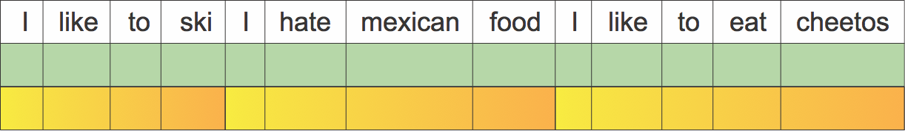
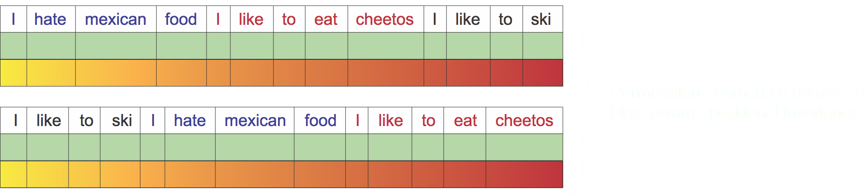
Encoding a Dialog and a Persona
We can play with these embeddings to manipulate the notion of a sequence
Repeating specific embeddings to control positioning information
We can also augment the dataset to bias towards positional invariance
Notes:
We can also play further with the notion of position, for example by reusing the same positional embeddings for each personality sentence therefore providing the model with a invariance over the order of the personality sentences.
Another way to get a similar result is to augment the dataset we use as training inputs for the model with input sequences containing permutations of the personality sentences order.

Slide 23
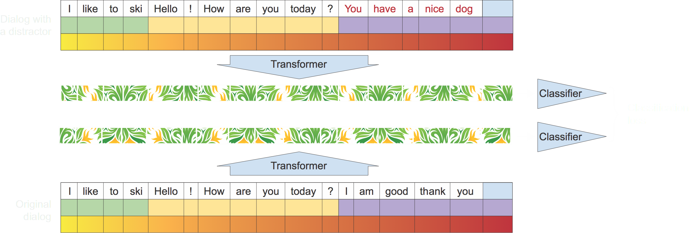
Semantic Learning on Dialog Utterances
Learning to distinguish a real answer from a distractor.
Combined with language modeling fine-tuning in a multi-task fashion
Notes:
Now that we have defined the input for our model, what kind of training objective should we use for the fine-tuning step?
We designed a classification objective that tries to capture a more general sense of dialog than just a short-range language modeling objective.
To compute this classification loss, the transformer is augmented with a classifier on top of the last hidden state associated to the last token of an input sequence. This classifier is trained during the fine-tuning of the transformer model to distinguish a real utterance from a distractor sampled for the training dataset.
We used a multi-task objective obtained by combining this classification loss with a language modeling loss that helps the model adapt to the specific vocabulary used in our dataset.

Slide 24
Results
Validation set (public) Leaderboard – Test set (hidden) Leaderboard
Notes:
The result of this choice of training procedure and model is a generative dialog agent with good performances and nice generalization properties as we can see when we compare the results obtained on the public validation set and the privately held test dataset.

Slide 25
That’s it for today
Thanks for listening!
thomas@huggingface.co

Slide 26


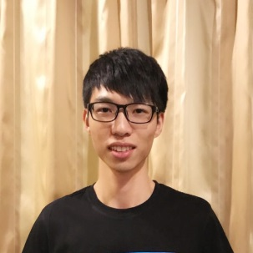
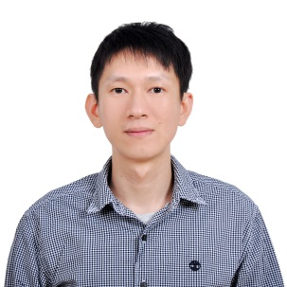
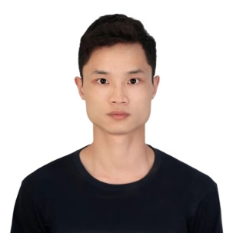
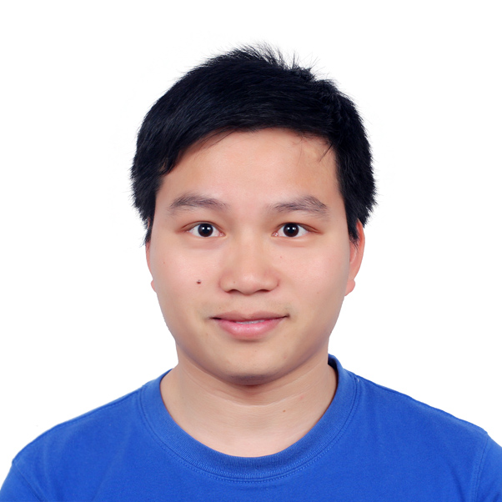
ConvAI2: Profile-Encoded Multi-Turn Response Selection via Multi-Grained Deep Match Network
Team: Little Baby(AI小奶娃)
Tencent PCG
Xiaowen ZHAO
Yanzhou HUANG
Zhenwei YI
Xuezheng PENG
Notes:
Hello everyone, My name is Xuezheng, I am from Tencent, shenzhen.
I am happy to be here to introduce our recent work on this challenge.
This is a teamwork with xiaowen, yanzhou and zhenwei, and our team name is LittleBaby.

Slide 27
Overview of ConvAI2
Aim of ConvAI2
Consistent personality
Long-term memory
More informative and engaging response
PersonaChat ConvAI2 Dataset
Total 1155 non-revised personas & 1155 revised personas
Persona chat: 162,064 utterances over 10,907 dialogs
Evaluation
Automated metrics [Perplexity, F1 and hits@k]
Amazon Mechanical Turk
Wild Live Chat with volunteers
Total 23 Teams & 3 baselines(ParlAI team)
Notes:
Let me make a brief overview of this challenge:
The aim of this challenge is toward a dialogue agent that can have consistent personality, maintaining a long-term memory, and gives more informative and engaging reply.
A Personachat dataset is provided, Thanks to the organizer. The dataset have totally 1155 personas, and grounded on these personas, over ten thousands dialogs are collected by crowd workers.
And the evaluation methods include automated metrics and human evaluation in different stage.
There are totally 23 teams join this challenge.

Slide 28
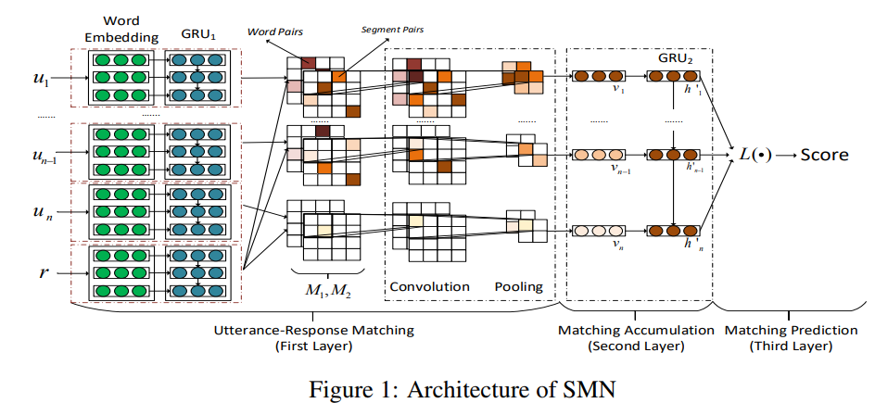
Our Baseline
(1)
(2)
(3)
(4)
Highlights:
(1) Model semantics for sentence
Word level and segment (GRU1) level
(2) Capture utterance-response matching
Cross match M1 & M2
(3) Distill important matching information
Convolution and pooling
(4) Capture temporal relationship of utterances
Recurrent neural network (GRU2)
Yu Wu et al., Sequential Matching Network: A New Architecture for Multi-turn Response Selection in Retrieval-based Chatbots. ACL 2017
Notes:
Our system are based on Sequential Matching Network, which was proposed by yu at ACL 2017.
Here is the architecture of this network, form which we summarized four highlights:
Firstly, candidate reply and history utterances are encoded in word and segment level.
Secondly, similarity matrix are construct to capture the matching information between candidate reply and each utterance.
Then, for each pair of utterance and reply, important matching information are distilled from these similarity matrix by CNN.
Finally the temporal relationship of utterances are modeled by a RNN, which output accumulative matching information for final prediction.

Slide 29
Possible Improvement?
(1) Better Model
(2) Data Augmentation
Notes:
Sequential matching network has several advantages:
First, multi-grained semantic information are extracted for each sentence.
And different kinds of matching information between the reply and each history utterance are captured at the very beginning.
Following this way, we try to go further in two aspects:
The first is to design a better model to capture more semantic and matching information,
And data augmentation are used to expand more training data.

Slide 30

Better Model
(1) Multi-grained representations
(2) More utterance-response matching
Text CNN for sentence representation
Word level & segment (GRU1, Bi-RNN, Bigram) level
Interaction
Multi-channel cross match
Cosine similarity
Column-wise sum & max of the word embedding
Notes:
Let me to be more details.
This is the architecture of the network we proposed, compared to the baseline:
we add bigram embedding and bi-rnn to capture coarse-grained and bi-directional semantic information.
We also use textCNN and simple column-wise pooing embedding for sentence-level representation.

Slide 31
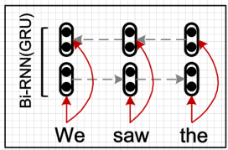
Baseline
Our Model
M1&M2
M1~M10
(2) More utterance-response matching
Notes:
For more utterance-response matching, we extend the number of matching matix to 10, as showed in this picture.
Experiment shows cross-match between different kind of semantic will also helps.
We also conduct corresponding interactive matching for representation from textCNN and simple sentence embedding, as shown on the right.

Slide 32
Data Augmentation
Introduce more diverse expressions:
Employing machine translation : en->3*cn->9*en
Performance is improved slightly
Top9 ens are too similar with the original en
Involving more pivot languages may helps: en->[cn,de,fr]->9*en
Generate more diverse negative instances:
Randomly masking or replacing tokens
Performance is degraded slightly
Lesson Learned: masking or replacing some insignificant tokens does not result in negative instances.
Notes:
For data augmentation, we try to use machine translation to introduce more diverse expression.
By using chinese as pivot language, we expand one original sentence to 9 sentences in different expression.
Experiments shows this will be slightly help.
We also find some sentences are too similar to the original sentence, this may result in weak effectiveness of augmentation.
We believe involving more pivot languages may helps.
We also tried to generate more negative instances by randomly mask or replace tokens, but the performance is degraded, mainly because these operation does not result in true negative instances.

Slide 33
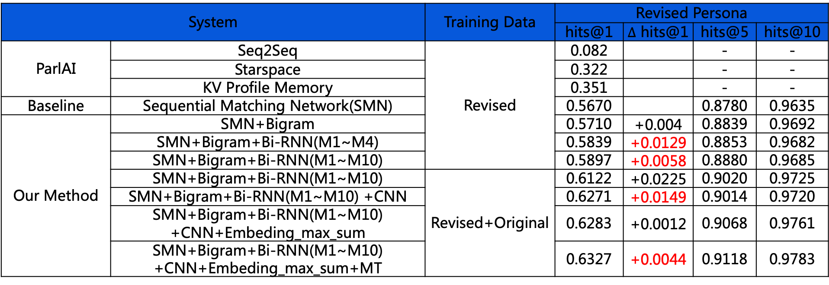
Experiment Results
System |  | Training Data | Revised Persona
 |  |  | hits@1 | $∆$ hits@1 | hits@5 | hits@10
ParlAI | Seq2Seq | Revised | 0.082 |  | - | -
 | Starspace |  | 0.322 |  | - | -
 | KV Profile Memory |  | 0.351 |  | - | -
Baseline | Sequential Matching Network(SMN) |  | 0.5670 |  | 0.8780 | 0.9635
Our Method | SMN+Bigram |  | 0.5710 | +0.004 | 0.8839 | 0.9692
 | SMN+Bigram+Bi-RNN(M1~M4) |  | 0.5839 | +0.0129 | 0.8853 | 0.9682
 | SMN+Bigram+Bi-RNN(M1~M10) |  | 0.5897 | +0.0058 | 0.8880 | 0.9685
 | SMN+Bigram+Bi-RNN(M1~M10) | Revised+Original | 0.6122 | +0.0225 | 0.9020 | 0.9725
 | SMN+Bigram+Bi-RNN(M1~M10) +CNN |  | 0.6271 | +0.0149 | 0.9014 | 0.9720
 | SMN+Bigram+Bi-RNN(M1~M10) +CNN+Embeding_max_sum |  | 0.6283 | +0.0012 | 0.9068 | 0.9761
 | SMN+Bigram+Bi-RNN(M1~M10) +CNN+Embeding_max_sum+MT |  | 0.6327 | +0.0044 | 0.9118 | 0.9783
Notes:
Here is the whole experiment results.
Since our system is retrieval-based system, Hits@K is the only automated metric that valid for our system.
We can see:
1. Bi-RNN and CNN improved the hits@1 significantly.
2. Cross match between different kind of semantic is also effective.
3. Data augmentation by machine translation can still improve on the final model.

Slide 34
Future Work
Sentence Semantic Modeling
Transformer
Learning sentence representations via unsupervised data
Data Augment
Machine Translation
History Reply
How to use the previous replies(top-5)?
Generative Methods
Try Generative model or ensemble with retrieval-based model
Notes:
For future work,
We’d like to apply transformer and other state-of-art sentence representation methods for more effective semantic modeling.
And as mentioned above, we can expect more from machine translation for data augmentation.
Please note that we did not use history reply in our model, we think it should be taken into consideration.
Finally, generative methods has shown great potential and we believe it will have brighter future in this area, we won’t miss it.

Slide 35
Thank you!

Slide 36
Experiment Results
System |  | Training Data | Revised Persona
 |  |  | hits@1 | hits@5 | hits@10
ParlAI | Seq2Seq | Revised | 0.082 | - | -
 | Starspace |  | 0.322 | - | -
 | KV Profile Memory |  | 0.351 | - | -
Baseline | Sequential Matching Network(SMN) |  | 0.5670 | 0.8780 | 0.9635
Our Method | SMN+Bigram |  | 0.5710 | 0.8839 | 0.9692
 | SMN+Bigram+Bi-RNN(M1~M4) |  | 0.5839 | 0.8853 | 0.9682
 | SMN+Bigram+Bi-RNN(M1~M10) |  | 0.5897 | 0.8880 | 0.9685
 | SMN+Bigram+Bi-RNN(M1~M10) | Revised+Original | 0.6122 | 0.9020 | 0.9725
 | SMN+Bigram+Bi-RNN(M1~M10) +HisReply |  | 0.6438 | 0.9166 | 0.9771
 | SMN+Bigram+Bi-RNN(M1~M10) +CNN |  | 0.6271 | 0.9014 | 0.9720
 | SMN+Bigram+Bi-RNN(M1~M10) +CNN+Embeding_max_sum |  | 0.6283 | 0.9068 | 0.9761
 | SMN+Bigram+Bi-RNN(M1~M10) +CNN+Embeding_max_sum+MT |  | 0.6327 | 0.9118 | 0.9783

Slide 37


The Conversational Intelligence Challenge 2, NIPS 2018 – solution using generative model
Presenter: Prerna Khurana, Researcher at TCS
Work by: Mohammad Shadab Alam, Senior Manager, Machine Learning Solutions, EXL (Inductis)
Notes:
The conversational intelligence challenge-2 or convai2 is a part of the NIPS competition track. During the course of this presentation we will discuss how we solved this challenge using generative modeling approach.
37

Slide 38

Objective of the Session
Sections | Content
ConvAI2: Overview of the competition | Data Challenges in evaluating open ended chat bots parlAI
Model Architecture | seq2seq + highway
Input and training strategy | Glove + language model vector Transfer learning strategy for seq2seq tasks
Result chart | Score progress chart
What the session will cover?
What the session will not cover?
Mathematics around seq2seq and language model
Notes:
The presentation is orchestrated as tabulated in this slide.
We will discuss the overview of the competition, about our model architecture and the training strategy.
Finally, we will discuss score progression chart.
38

Slide 39
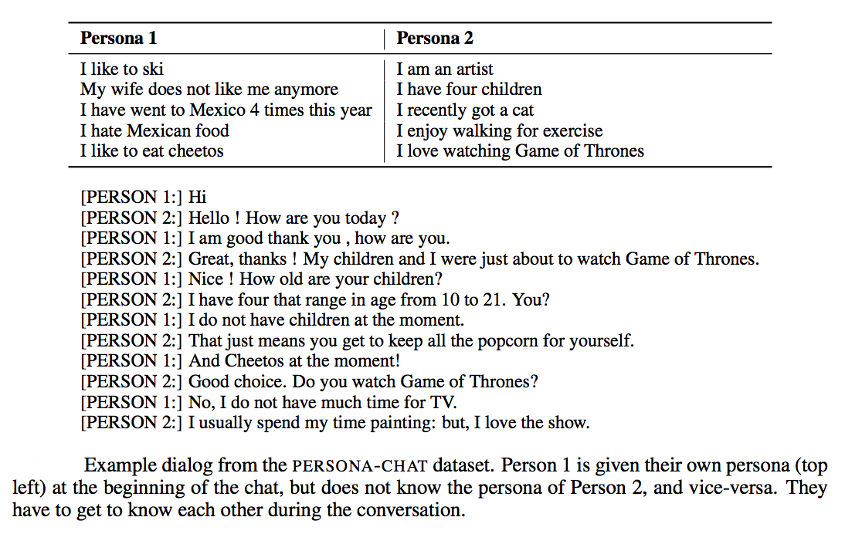

ConvAI2: Overview of the competition: data [1]
To develop a non-goal oriented generative dialogue agent having a consistent persona. As per the convai2 competition guidelines, the agent should be able to:
1. Engage its user
2. Reveal its persona
Dataset:
Utterances: 164,356
Dialogs: 10,981
Persona: 1155
Profile sentences/persona: 4-5
Personas in test: 200
[1] Alexander H. Miller, Will Feng, Adam Fisch, Jiasen Lu, Dhruv Batra, Antoine Bordes, Devi Parikh, and JasonWeston. Parlai: A dialog research software platform.CoRR, abs/1705.06476,2017.
Notes:
The objective of this challenge was to develop a model (or dialogue agent) which can interact with users.
Its performance is judged not only by evaluation metrics but also by human feedback.
We will talk about the necessity to involve humans in evaluation in the next slide.
The data set consists of dialogue between two people, who have been given special instructions, to try to reveal as much information as possible about themselves and at the same time try to know about the person with whom they are chatting with. Each individual is assigned a profile (or persona) they are supposed to talk about during the course of the dialogue.

Slide 40
ConvAI2: Overview of the competition: Challenges
Utterance: I like to eat pizza, what about you ?
Response: 1
Response: 2
No evaluation metric is appropriate to capture the accuracy of response
Humans are the best evaluators
Three evaluation metrics – ppl,hits@1 and f1 score
Wow, looks like we have similar taste!
I like to go on long walks.
Response: 3
Response: 4
I like it too, I prefer Pizza Hut over Domino’s.
My kids like to eat pizza, do you have kids?
Response depends upon past conversation and persona of the customer
Notes:
There is a major challenge involved in evaluating open ended dialogue systems:
During model training, a model is exposed only to a limited set of responses, but, in fact, there can be multiple responses which can be considered correct. As represented above, lets assume that the utterance in green (I like to eat pizza, what about you ?) and its response in blue (I like it too, I prefer Pizza Hut over Domino’s.) belong to the validation set.
A model which produces any of the responses (1,2,4) can be considered acceptable. However, responses (1,2,4) are more likely to generate lower evaluation score using any chosen evaluation criterion. Hence, it become necessary to judge a model over as many evaluation criterion as possible, which was done in this competition. It is also assumed, however, that a model which is acceptable, will at least try to give more weight to words which are present in the expected response (Response: 3 in this case).
In order to make a final model selection, hence, it becomes imperative that it is evaluated by us, humans.

Slide 41

ConvAI2: Overview of the competition:
ParlAI [1] (pronounced “par-lay”) is a framework for dialog AI research, implemented in Python.
Its goal is to provide researchers:
a unified framework for sharing, training and testing dialog models
many popular datasets available all in one place, with the ability to multi-task over them
seamless integration of Amazon Mechanical Turk for data collection and human evaluation
integration with Facebook Messenger to connect agents with humans in a chat interface
Many tasks are supported, including popular datasets such as SQuAD, bAbI tasks, MS MARCO, MCTest, WikiQA, WebQuestions, SimpleQuestions, WikiMovies, QACNN & QADailyMail, CBT, BookTest, bAbI Dialog tasks, Ubuntu Dialog, OpenSubtitles, Cornell Movie, VQA-COCO2014, VisDial and CLEVR. See here for the current complete task list.
Our model is developed in pytorch. Training and prediction modules are integrated with the ParlAI platform
[1] https://github.com/facebookresearch/ParlAI
Notes:
We relied heavily on inbuilt utilities of ParlAI platform which are well suited to perform data pre-processing, model development and training. We have defined out own deep learning architecture (or an agent), embedding and have integrated it with the platform.

Slide 42
model: Input
Language embeddings are trained and fine tuned using Universal Language Model Fine-tuning (ULMFiT), a technique proposed by Howard et al. [1]. As shown below, each word is represented by the fine tuned language embedding vector concatenated with the GloVe [2] word vector.
Persona – Training data
ULMFiT – Embedding fine tuning
Language Embedding (400)
GloVe (300)
Language Embedding (400)
Input vector (700)
Pre-trained GloVe vectors
Language model is fine-tuned on the training set
[1] Jeremy Howard and Sebastian Ruder. Fine-tuned language models for text classification. CoRR, abs/1801.06146,2018.
[2] Jeffrey Pennington, Richard Socher, and Christopher D. Manning. Glove: Global vectors for word representation. In In EMNLP, 2014.
Notes:
When compared to a basic seq2seq encoder and decoder network, enhancements have been made at three stages:
Stage1: Input embedding
Stage2: Model architecture
Stage3: Training strategy to make use of external data
As shown here, each word is represented by a vector of length 700. We have obtained language embedding (of length 400) after retuning the ULMFiT model on the provided “original” data. ULMFiT makes use of LSTM network to capture long term dependencies, and has been found to produce state of the art results on the classification task after tuning the embedding (which has been tuned on Wikipedia data) on the data of interest.
Pre-trained embedding from GloVe is concatenated with the language embedding to form a vector of length 700.

Slide 43
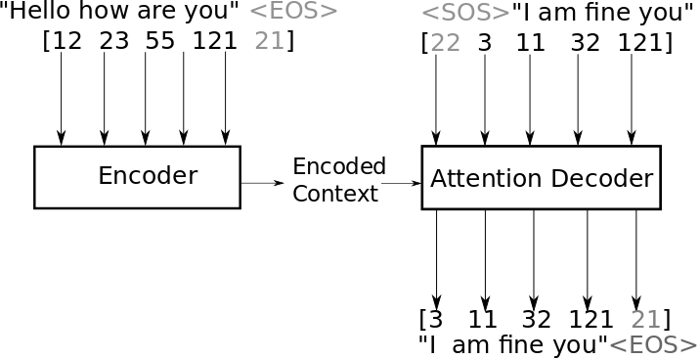
model: Architecture
Encoder output (x)
HIGHWAY LAYER [1]
R = σ(x) ⊗ f (H(x)) + (1 − σ(x)) ⊗ W (x)
here, x is input (encoder hidden layer output),
σ(x) and H(x) are sigmoid functions, whereas
f (x) and W (x) are linear functions
Baseline- seq2seq network
Transformed encoder output (x’)
Since this is not a translation task, raw attention also provided additional lift, could not be used due to system limitations
Enhancements over baseline seq2seq network
Length of encoder output = 1024, highway network helps in removing bias carried forward in the network
[1] Rupesh Kumar Srivastava, Klaus Greff, and Jürgen Schmidhuber. Highway networks. CoRR, abs/1505.00387, 2015.
Notes:
Stage 2, enhancement is done in the basic seq2seq encoder/decoder architecture (provided in the ParlAI). Baseline network consists of encoder and decoder blocks, both of these blocks are based on LSTM architecture. Encoder encodes the input in a fixed length hidden representation. Which then acts as an input to the decoder. Decoder decodes the next word based on the encoded context and the current word. To assist decoder focus on relevant encoded context an attention layer is also trained which shrinks the non-relevant encoded elements.
In the enhanced architecture, a highway layer is introduced just after the encoder output. Highway layer acts as a gate and allows those encoded elements to pass which contribute more in the decoder decision making. In other words, its function is to reduce the bias present in the encoder output due to word embedding which are initially trained on huge corpus belonging to some another domain (Wikipedia).
Highway layer also helped in fast convergence but that analysis needs to be carried out separately and is not a part of this presentation.

Slide 44
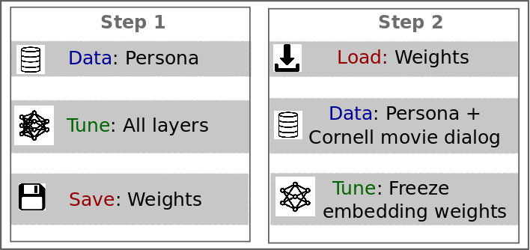
model: training
Two step model training
Vocabulary must be fixed as per the persona training dataset
Notes:
Stage 3 enhancement is done in order to make use of external “Cornell Movie dialogue” dataset.
Step-1 of training makes use of enhanced architecture and input embedding. The model is trained on the “original” persona data till convergence. And the model state is saved. During this step vocabulary is finalized.
In Step-2, data is augmented with the Cornell movie dialogue dataset. Weights saved in the previous step are loaded and embedding matrix of both encoder and decoder is frozen. Model is trained till convergence.
Validation data for both the training steps remain same.
By freezing the embedding weights during step-2 training, it is ensured that the new data does not corrupt the input representation. Other weights are tuned which helps model in learning new sequence patterns, which in turn helps in improving the overall model performance.
44

Slide 45
model: score progress
Score-Progression
Data/Input
Model
Val-ppl
Convai – persona/glove
seq2seq+attention (base model)
36.5
Convai – persona/glove
base model + highway
35.57
Convai – persona/glove + lm
base model + highway
35.16
Convai – persona + Cornell /glove+lm
base model + highway
34.12
Novelty:
Architecture – Highway
Input – Language Model
Training strategy – Make use of external data
Notes:
Although three evaluation criterion could be used, we observed that an improvement in ‘ppl’ resulted in the visible improvement in the model performance, hence, it was tracked as the criterion to evaluate different models.
The baseline seq2seq model from ParlAI was forked in the month of August, resulted in a validation ppl of 36.5
After introducing the highway layer the score improved to 35.57
Enhancing embedding from 300 (GloVe) to 700 (GloVe + lm) further improved the score to 35.16
Finally, using external data with our training strategy resulted in the winning score.
45

Slide 46
Thank you!
Email-Office: mohd.alam@exlservice.com
Email-Personal: malam.shadab@gmail.com
Kaggle: https://www.kaggle.com/outliar
Github: https://github.com/codesrepo
Phone +91-991058394
Notes:
We will open source the codes soon. You can contact us for any further details.
Email-Office mohd.alam@exlservice.com Email-Personal malam.shadab@gmail.com Kaggle https://www.kaggle.com/outliar Phone +91-991058394
46

Slide 47

ADAPT Centre Submission to the ConvAI2 Challenge
Christian Saam TCD, Henry Elder DCU
The ADAPT Centre is funded under the SFI Research Centres Programme (Grant 13/RC/2106) and is co-funded under the European Regional Development Fund.

Slide 48
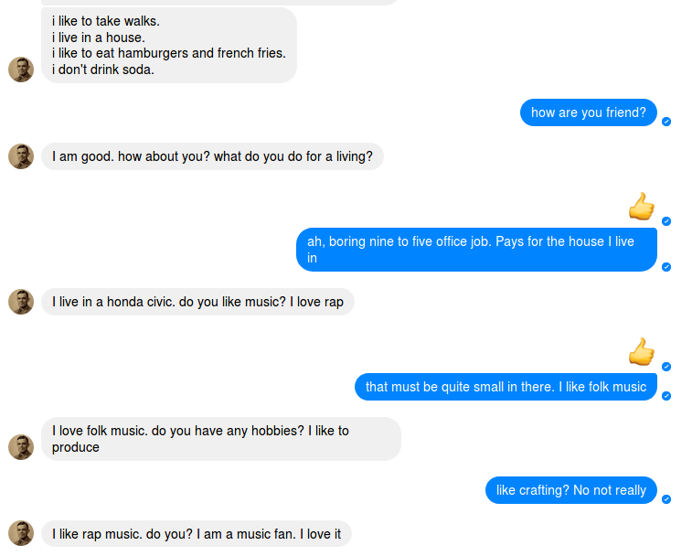
Our Bot

Slide 49
Motivation of Approach
Dialog modelling as translation
end-to-end sequence-to-sequence model [Vinyals+15]
use strong NMT baseline: openNMT-py [Klein+17]
Transformer (SOA NMT model) overfit very quickly (too little data?), use recurrent encoder/decoder
Dialog modelling as summarization
copy attention for accuracy/coherence/unknown words

Slide 50
Motivation of Approach (continued)
Dialog Modelling as (conditioned) Language Modelling
learn language, then learn conversation (pre-training)
simple well tuned LMs perform well [Melis+18]
encoder as LM, decoder as conditioned LM
skewed data distribution causes decoder disconnect (simply output most likely sentence w/o conditioning on input)
additional sequence loss on encoder → multi-tasking
split encoder/decoder for independent LM pre-training (on non-paired data)

Slide 51
System Overview
Encoder
Bi-directional
LSTM
3 layers with 512 units
Context gate [Tu+17]
Attention
Global attention [Luong+15]
Input feeding [Luong+17]
Copy attention [See+17]
Decoder
Uni-directional
LSTM
1 layer with 512 units

Slide 52
Language Modelling Bag of Tricks
Pre-trained embeddings (GloVe, d=300) [Pennington+14]
Shared embedding matrices (input/output, en-/decoder) [Inan+17]
Mixture of Softmaxes classifier(s) (𝑛=10) [Yang+18]
Label smoothing (𝜀=0.1) [Szegedy+16]
Regularization
Dropout: inter-layer (𝑝=0.4), recurrent (weight dropping) (𝑝=0.5) [Merity+17], embedding (𝑝=0.1), embedding input (𝑝=0.65), embedding output (𝑝=0.3), embedding latent (𝑝=0.2) - locked dropout [Gal+16]
RNN 𝐿₂ activation regularisation (𝒉=1.0) [Merity+17]
Maximum gradient norm (𝒈̂=5.0)
Notes:
-enc_layers 3 -dec_layers 3 -encoder_type brnn -decoder_type rnn
-rnn_type LSTM -rnn_size 512 \
-word_vec_size 300 \
-share_embeddings -share_decoder_embeddings \
-pre_word_vecs_enc $embed \
-label_smoothing .1 \
-mixture_of_softmaxes -mos_n_experts 10 \
-dropout 0.4 -dropout_rnn 0.5 \
-drop_emb_embed 0.1 -drop_emb_input 0.65 \
-drop_emb_output 0.3 -drop_emb_latent 0.2 \
-batch_size 30 \
-encoder_lm_loss -enc_lm_loss_dbl_bp -regularize_output_norms \
-optim adam -adam_beta2 0.998 -decay_method noam -warmup_steps 6000 \ -learning_rate 3 -max_grad_norm 5 -param_init 0 -param_init_glorot \

Slide 53
Training and Optimization
Training:
ADAM
𝛽₁=0.9, 𝛽₂=0.998, 𝜀=10⁻⁹
learning rate schedule:
6000 steps linear warmup, inverse square root decay [Vaswani+17]
Runtime optimisation:
F1 score parameter optimisation with HyperOpt [Bergstra+15]
Perplexity score parameter optimisation with HyperOpt
Decoding optimisation with SigOpt

Slide 54
Data Preparation
Always prepend full persona
Simple truncated history
Simple tagged data format
Input
<pers> tok … tok <pers> … <src> … <tgt> … <src> …
Output
tok tok … tok
Additional pre-training data (not used in final system)
Switchboard [Calhoun+10]
Open Subtitles [Tiedeman+09]

Slide 55
Problems with Generation
Problem: Coherence
Solution: ???, better language modelling
Problem: Diversity
Solution: Random sampling / temperature
Problem: Repetition, repetition and and and and and and and and and
Solution: Constrained decoding
Notes:
What are the problems with language generation
So what did we do
We tried our best to get a good language model
We combined temperature with beam search. Temperature is a way of altering the probability distribution of the next word and doing better random sampling over that than you could with original distribution. Rare words become more probable
And then we had a series of rule based checks and constraints on the decoding to make sure we got something reasonable

Slide 56
Decoding
Human eval defaults
Temperature 1.4
Min length 17
Beam size 4
Block N-gram repeat beam search
2-grams in same sentence
3-grams from the history or persona
Return top 4 beams
Check for issues in output
Language model breakages
e.g. and and and and and
A non-stop word is repeated in the sentence
e.g. I like books but I do not enjoy books
If issue detected rerun generation
If it keeps failing loosen the defaults
Temperature++, beam size++, min length--
Notes:
Most of the defaults are standard. Beam size, temperature, we set a minimum length for the number of tokens in a generated sentence
Then we added additional constraints to the beam search to prevent repetition
And then we returned the top 4 sentences from this.
Then we check for issues in the output. Really the only things we could reliably check for with simple regexes were the clearly broken ones. And for repeated non stop words.
If we detected any of these we would rerun the generation with looser constraints

